Slide 1
Scheduler Activations: Effective Kernel Support for the User-level Management of Parallelism
Thomas E. Anderson, Brian N. Bershad, Edward D. Lazowska, and Henry M. Levy
Presented by Reinette Grobler

Slide 2
Managing Concurrency Using Threads
User-level library
  Management in application’s address space
  High performance and very flexible
  Lack functionality
Operating system kernel
  Poor performance (when compared to user-level threads)
  Poor flexibility
  High functionality
New system: kernel interface combined with user-level thread package
  Same functionality as kernel threads
  Performance and flexibility of user-level threads

Slide 3
User-level Threads
Thread management routines linked into application
No kernel intervention == high performance
Supports customized scheduling algorithms == flexible
(Virtual) processor blocked during system services == lack of functionality
  I/O, page faults, and multiprogramming cause entire process to block
Process
(“virtual processor”)
User space
Thread
Kernel space
Runtime system
Thread table
Process table
Notes:
No kernel intervention
No traps to kernel when switching threads
No context switch
Memory cache not flushed
Flexible
Supports multiple parallel programming models/customized scheduling algorithms.
Customization to the needs of the language or the user without any kernel modifications.
Functionality
Reason why some user-level threads implementations require special non-blocking system calls or to check safety before performing a system call (use a “select” before “read”).
Authors assert that the stated poor functionality is due to a lack of kernel support and not inherent to the usage of user-level threads.
Now cause poor performance of user-level threads

Slide 4
Kernel Threads
No system integration problems (system calls can be blocking calls) == high functionality
Extra kernel trap and copy and check of all parameters on all thread operations == poor performance
Kernel schedules thread from same or other address space (process)
Single, general purpose scheduling algorithm == lack of flexibility
Process
User space
Thread
Kernel space
Thread table
Process table
Notes:
Performance
Overhead is much better than managing processes, but worse than user level threads
A blocked thread is noticed by kernel and its processor can be reallocated to other runnable thread.

Slide 5
Kernel Threads Supporting User-level Threads
Question: Can we accomplish system integration by implementing user-level threads on top of kernel threads?
Typically one kernel thread per processor (virtual processor)
  User-level thread blocks, so does kernel thread: processor idle
  More kernel threads implicitly results in kernel scheduling of user-level threads
  Increasing communication between kernel and user-level will negate performance and flexibility advantages of using user-level threads
Answer: No
Also:
  No dynamic reallocation of processors among address spaces
  Cannot ensure logical correctness of user-level thread system built on top of kernel threads
Notes:
General points about kernel threads:
Kernel level threads block, resume, and are preempted without notification to user level
Kernel threads scheduled obliviously with respect to user state.
User-level thread blocks, so does kernel thread: processor idle
Same functionality problem dealing with system services as user-level threads implemented by processes
More kernel threads than processors would implicitly cause the operating system to schedule user level threads
An idle user level thread can now preempt a running thread
A low priority user-level thread can preempt a high priority thread
Dynamic reallocation of processors among address spaces in response to variations in parallelism is important to achieve high performance. If processors are not reallocated then it is possible that processors can be idle while there are waiting but runnable threads. If new program starts then processors need to be reallocated and thus kernel threads are preempted – affects user-level threads similar to I/O and page faults.
Cannot ensure logical correctness of user-level thread system built on top of kernel threads
Synchronization mechanisms assume that all runnable threads will eventually run. But if there are more runnable user-level threads than available processors then this assumption does not hold true.
Summary
kernel threads similar performance as user-level threads supported by processes.
Kernel threads suffer from same problems when dealing with system services as user-level threads on processes

Slide 6
New Thread Implementation
Goal: System with the functionality of kernel threads and the performance and flexibility of user-level threads.
High performance without system calls.
Blocked thread can cause processor to be used by another thread from same or different address space.
No high priority thread waits for processor while low priority runs.
Application customizable scheduling.
No idle processor in presence of ready threads.
Challenge: control and scheduling information distributed between kernel and application’s address space.
Notes:
Challenge:
Knowledge about scheduling information at user level needed by kernel to allocate processors.
Knowledge about kernel events are needed by user level to make scheduling decisions

Slide 7
Virtual Multiprocessor
Application knows how many and which processors allocated to it by kernel.
Application has complete control over which threads are running on processors.
Kernel notifies thread scheduler of events affecting address space.
Thread scheduler notifies kernel regarding processor allocation.
User space
Kernel space
(“virtual multiprocessor”)
Notes:
Kernel notifies thread scheduler
When number of allocated processors change
When user-level thread blocks and wakes up in kernel

Slide 8
Scheduler Activations
Vessels for running user-level threads
One scheduler activation per processor assigned to address space.
Also created by kernel to perform upcall into application’s address space
  “Scheduler activation has blocked”
  “Scheduler activation has unblocked”
  “Add this processor”
  “Processor has been preempted”
Result: Scheduling decisions made at user-level and application is free to build any concurrency model on top of scheduler activations.
Notes:
Upcalls
Has consequence that all scheduling decisions are left up to the user-level
Processor being preempted has two issues:
If thread is in critical section then it will be continued temporarily via user level context switch until it is done
Preemption of processor will result in two threads preempted, one for the lost processor, and one for the message about the lost processor

Slide 9
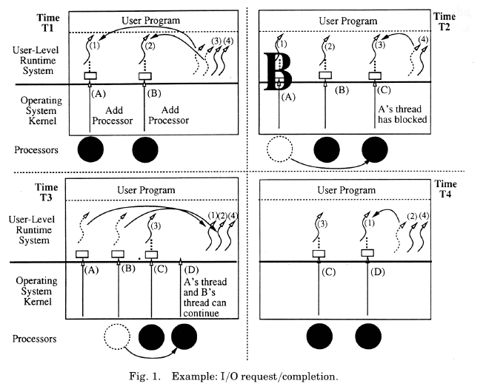
Scheduler activations (2)

Slide 10
New Thread Implementation
Goal: System with the functionality of kernel threads and the performance and flexibility of user-level threads.
High performance without system calls.
No high priority thread waits for processor while low priority runs.
Blocked thread can cause processor to be used by another thread from same or different address space.
Application customizable scheduling.
No idle processor in presence of ready threads.
Challenge: control and scheduling information distributed between kernel and application’s address space.
Notes:
Challenge:
Knowledge about scheduling information at user level needed by kernel to allocate processors.
Knowledge about kernel events are needed by user level to make scheduling decisions

Slide 11
Processor allocation
Goal: No idle processor in presence of runnable threads.
Processor allocation based on available parallelism in each address space.
Kernel notified when:
  User-level has more runnable threads than processors
  User-level has more processors than runnable threads
Kernel uses notifications as hints for its actual processor allocation.

Slide 12
Implementation
Scheduler activations added to Topaz kernel thread management.
  Performs upcalls instead of own scheduling.
  Explicit processor allocation to address spaces.
Modifications to FastThreads user-level thread package
  Processing of upcalls.
  Resume interrupted critical sections.
  Pass processor allocation information to Topaz.
Notes:
1) Topaz is the native operating system for the DEC

Slide 13
Performance
Thread performance without kernel involvement similar to FastThreads before changes.
Upcall performance significantly worse than Topaz threads.
  Untuned implementation.
  Topaz in assembler, this system in Modula-2+.
Application performance
  Negligible I/O: As quick as original FastThreads.
  With I/O: Performs better than either FastThreads or Topaz threads.

Slide 14
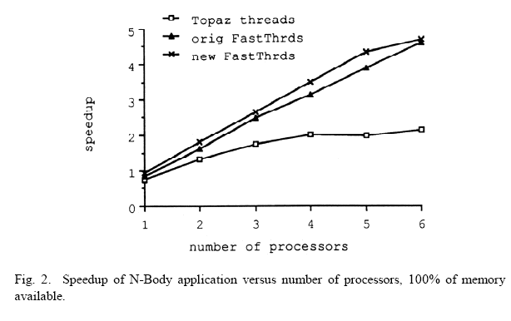
Application Performance (negligible I/O)

Slide 15
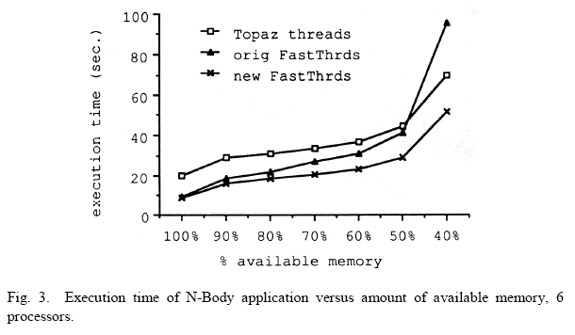
Application Performance (with I/O)

